Slide 1

Library Management System (DAMG 6210)
Group 10
Professor: Manuel Montrond

Slide 2






Chetan Warad
Team Members
Sachin Vishaul Baskar
Rutwik Ganagi
Dennis Sharon
Ashwin Badamikar
Chetan Warad

Slide 3

PROJECT OVERVIEW:
The project addresses manual library management inefficiencies, including error-prone tracking of reservations, delayed fine processing, and fragmented data access. It offers an automated SQL database solution with centralized resource tracking, policy-enforcing triggers/stored procedures, and real-time operational analytics via optimized views.

Slide 4
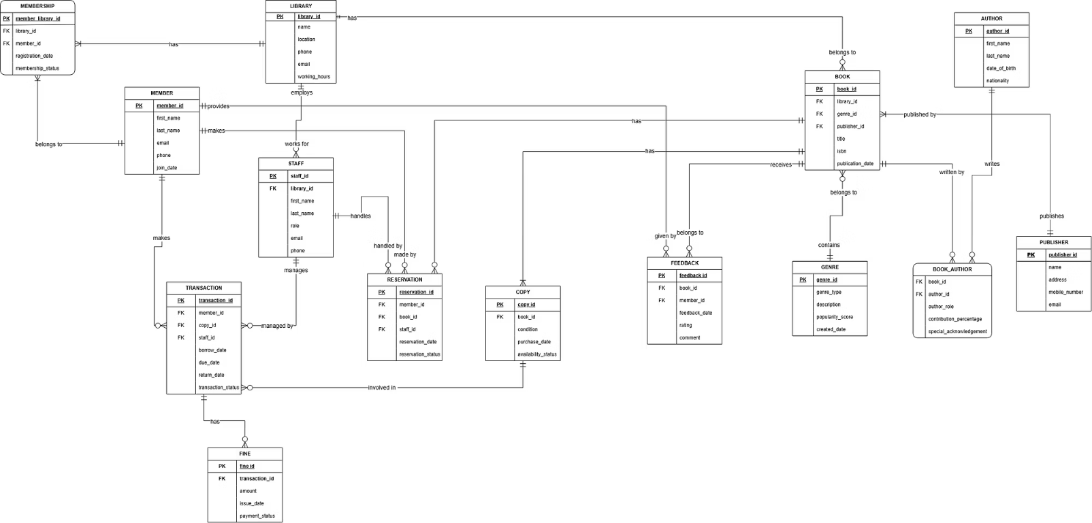
Entity Relationship Diagram (ERD)

Slide 5
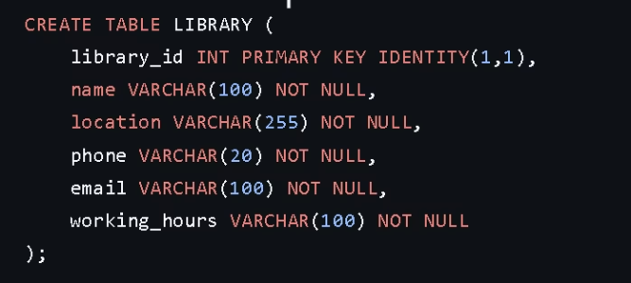
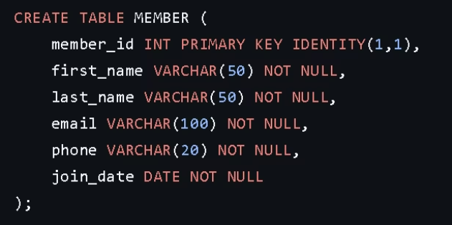
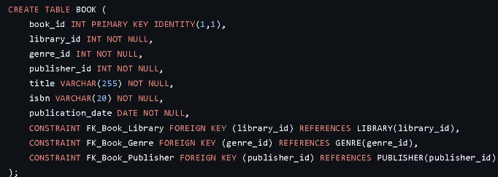
Data Definition Language (DDL)
These DDLs define the core structure of our Library Management System.

Slide 6
CONSTRAINTS
The database uses the following constraints to ensure data integrity:
Primary Keys: Each table uses a unique IDENTITY column as its primary key (e.g., library_id, member_id, book_id).
Foreign Key Constraints: Ensure data integrity across related tables (e.g., BOOK links to LIBRARY, GENRE, PUBLISHER).
Many-to-Many Relationships: Managed via junction tables (e.g., BOOK_AUTHOR connecting BOOK and AUTHOR).
Check Constraints: Enforce valid data entries (e.g., GENRE’s popularity_score between 0 and 10, valid conditions in COPY).
Operational Table Relationships: Tables like TRANSACTION, RESERVATION, FEEDBACK, FINE, MEMBERSHIP maintain consistent and reliable relationships.

Slide 7

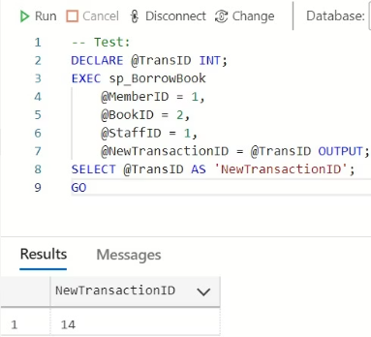

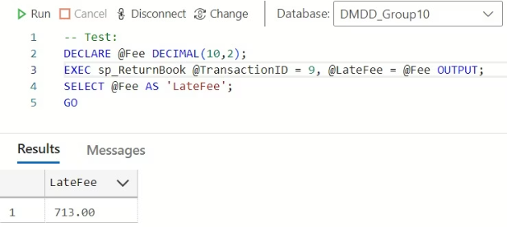
Stored Procedures
Borrow Book (sp_BorrowBook):
This stored procedure facilitates the borrowing of a book by a library member, processed by a staff member. Upon successful execution, it returns a unique transaction ID.
Return Book (sp_ReturnBook):
This stored procedure allows a member to return a previously borrowed book using the original borrowing transaction ID. A User-Defined Function (UDF) calculates any applicable late fees, which are then returned as output.

Slide 8



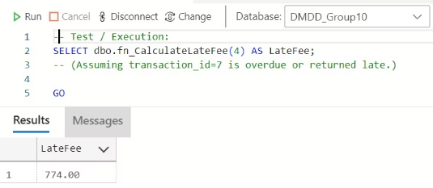
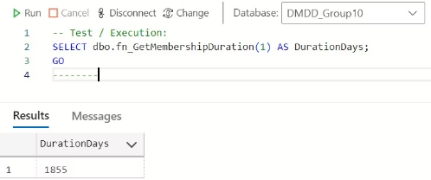
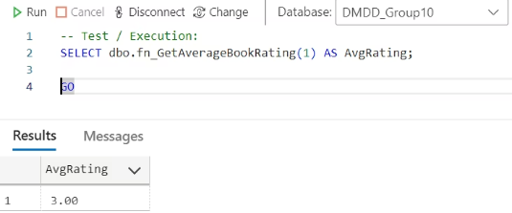
User-Defined Functions (UDFs)
Calculate Late Fee
Membership Duration
Average Book Rating
Given a transaction_id, returns the late fee based on how many days overdue the book is
Returns the number of days since a membership’s registration_date.
Returns the average (1-5) rating for a given book_id from the FEEDBACK table

Slide 9
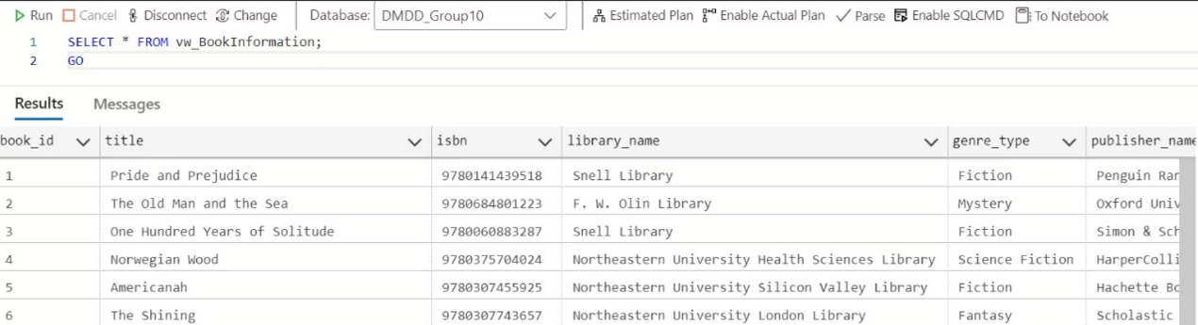
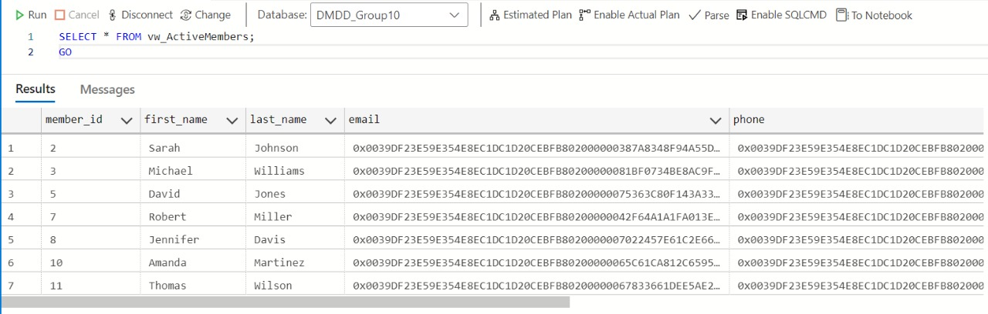
Views
Book Information
Combines book, library, genre, and publisher details.
Active Members
Shows members with active memberships.

Slide 10
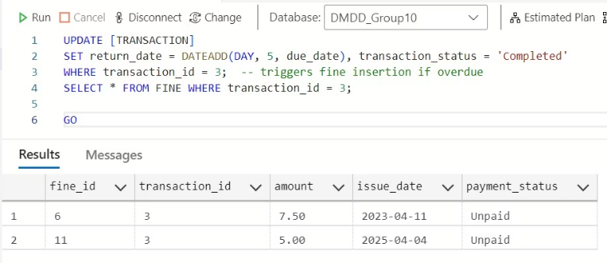
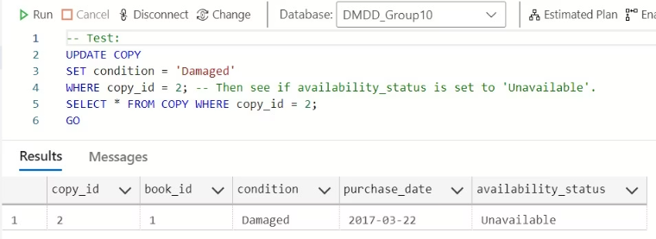
Triggers
1
Auto Fine trigger
After UPDATE on TRANSACTION. If transaction_status changes to 'Completed' and the book is returned late, automatically insert a Fine using UDF: fn_CalculateLateFee
2
Copy Condition trigger
After UPDATE on COPY. If condition changes to 'Damaged', automatically set availability_status to 'Unavailable'

Slide 11


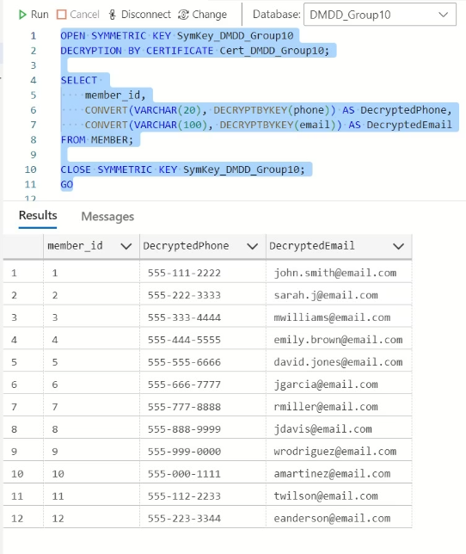


Encryption Process:
Setup
Add VARBINARY columns.
Security
Create Master Key and Certificate.
Encryption Key
Generate AES_256 key.
Data Encryption
Encrypt phone and email data.
Cleanup & Access
Rename encrypted columns; decrypt data when needed.

Slide 12
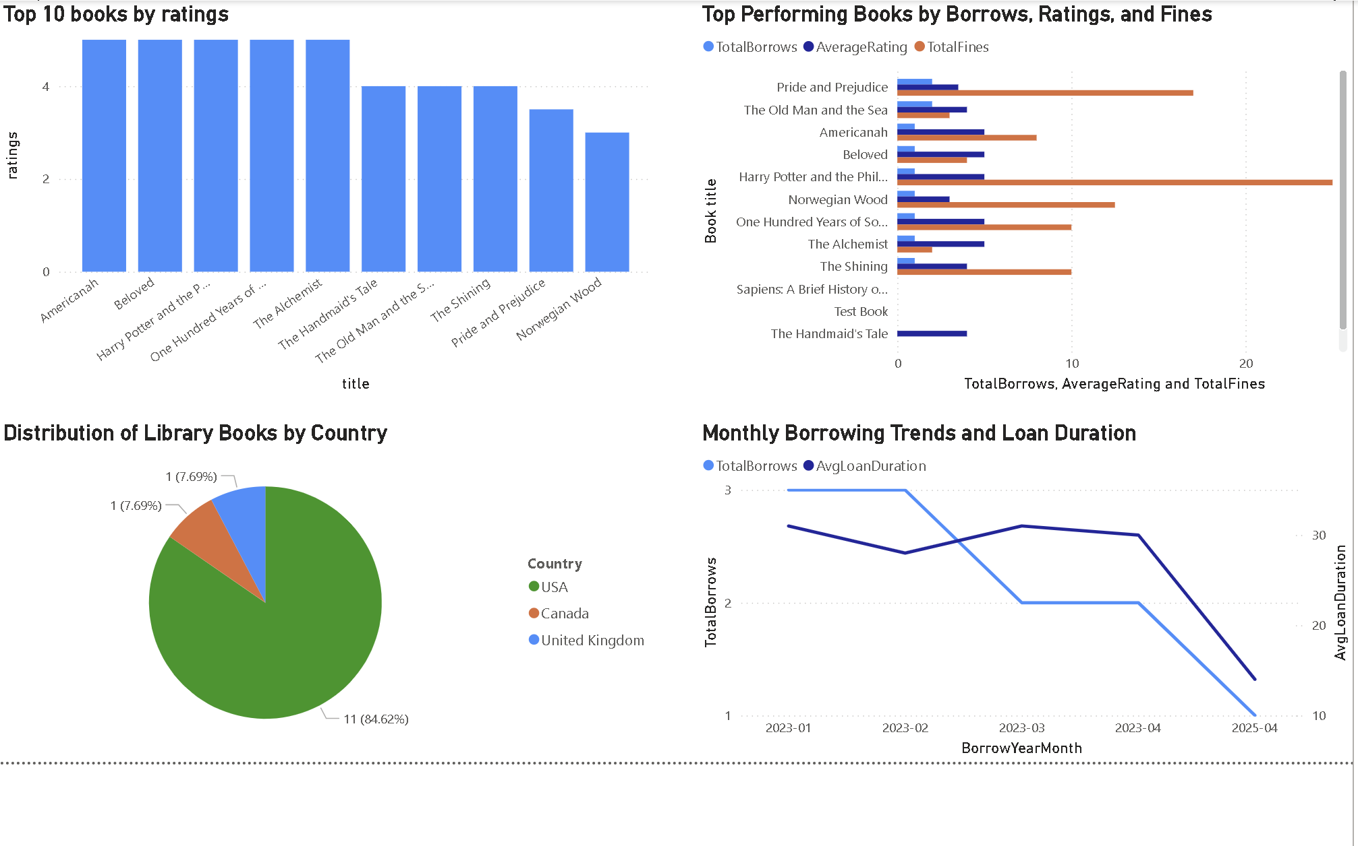
Power BI Visualizations

Slide 13
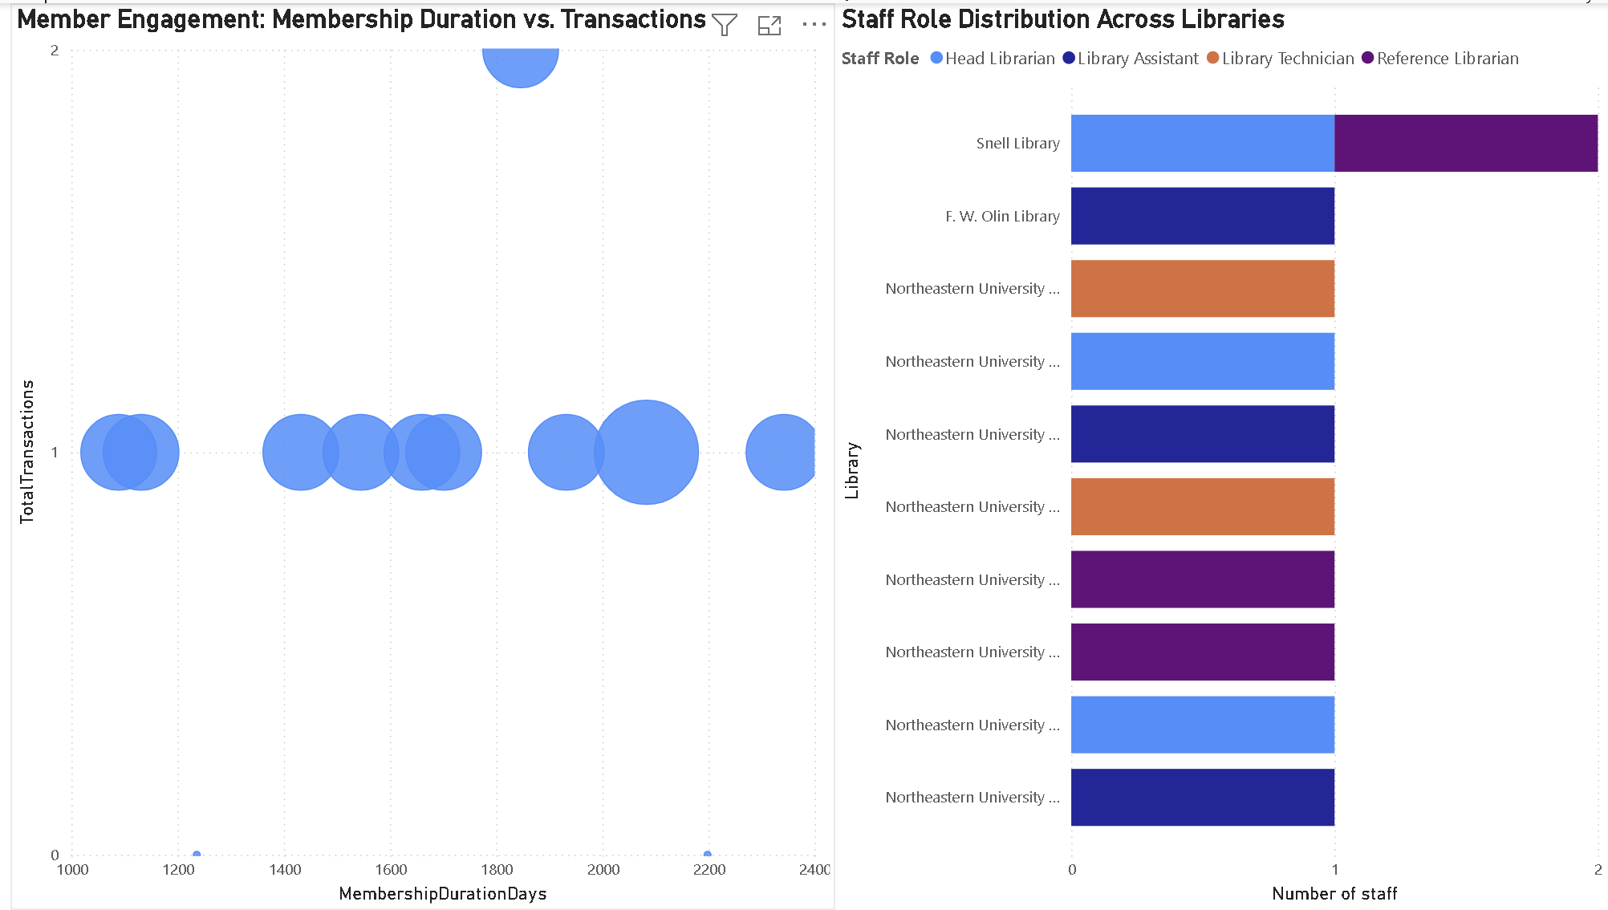
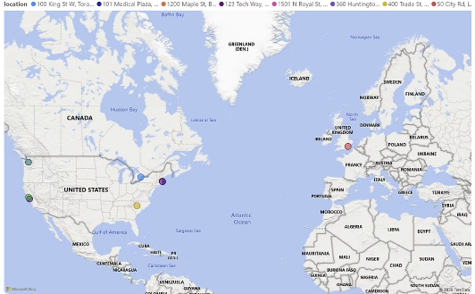

Slide 14

Thank You!

